Slide 1
Bundle Adjustment Optimization and the Role of Sparsity

Slide 2
Introduction to Bundle Adjustment
Bundle Adjustment (BA) is a nonlinear optimization process that refines 3D structure (points) and camera parameters simultaneously by minimizing the reprojection error across multiple views.
In essence:
It adjusts (“bundles”) all parameters so that the projected 3D points match the observed 2D image features as closely as possible.
Objective Function:
min Σ||x_ij - f(P_i, X_j)||²
Applications:
- Structure-from-Motion (SfM)
- Visual SLAM
- Camera calibration

Slide 3


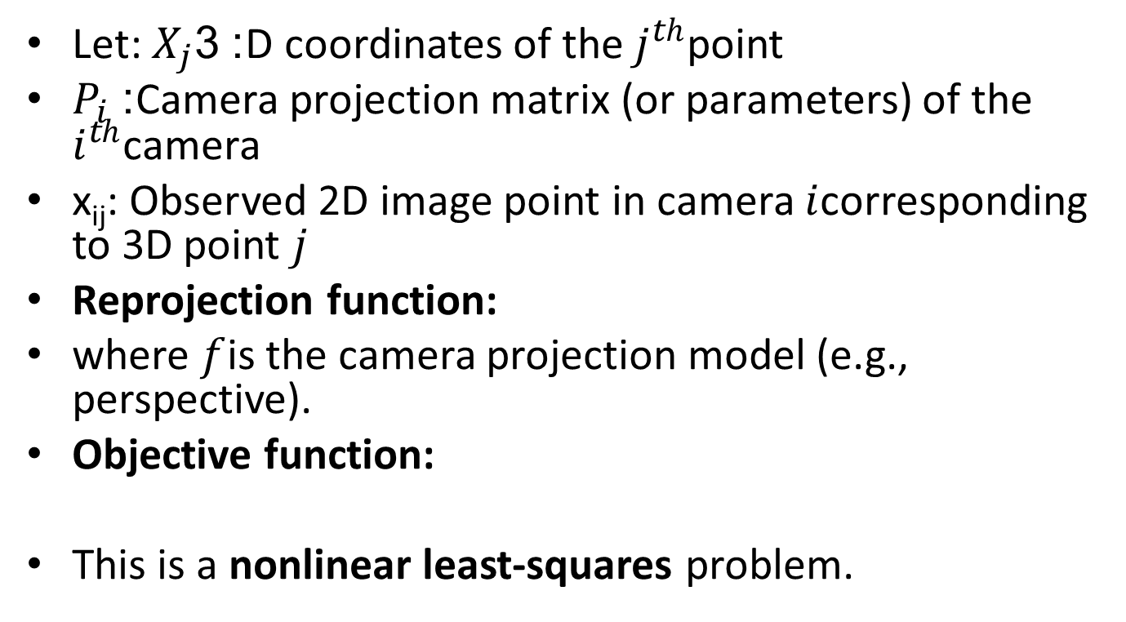
Mathematical Formulation
Let: $X_{j}$: 3D coordinates of the $j^{th}$point
$P_{i}$: Camera projection matrix (or parameters) of the $i^{th}$camera
x_{ij}​: Observed 2D image point in camera $i$corresponding to 3D point $j$
Reprojection function:
where $f$is the camera projection model (e.g., perspective).
Objective function:
This is a nonlinear least-squares problem.

Slide 4

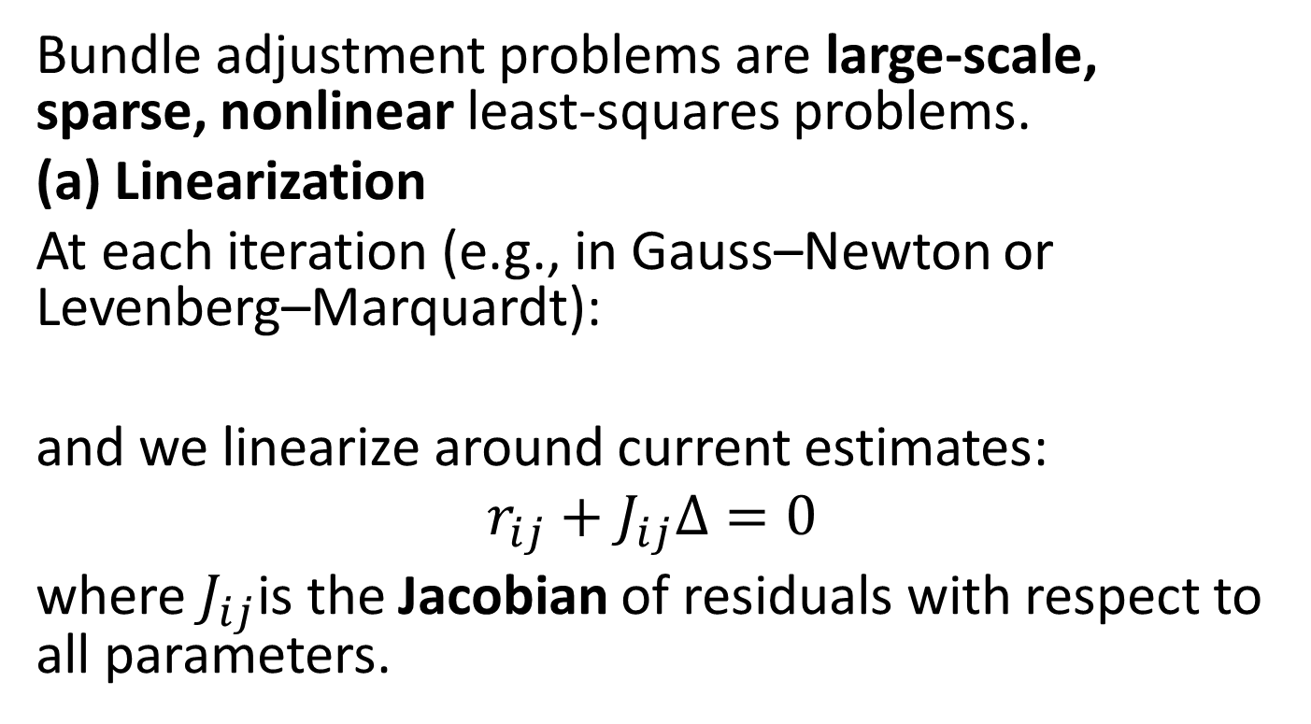
Optimization Strategies
Bundle adjustment problems are large-scale, sparse, nonlinear least-squares problems.
(a) Linearization
At each iteration (e.g., in Gauss–Newton or Levenberg–Marquardt):
and we linearize around current estimates:
$$r_{ij}+J_{ij}Δ=0$$
where $J_{ij}$is the Jacobian of residuals with respect to all parameters.

Slide 5
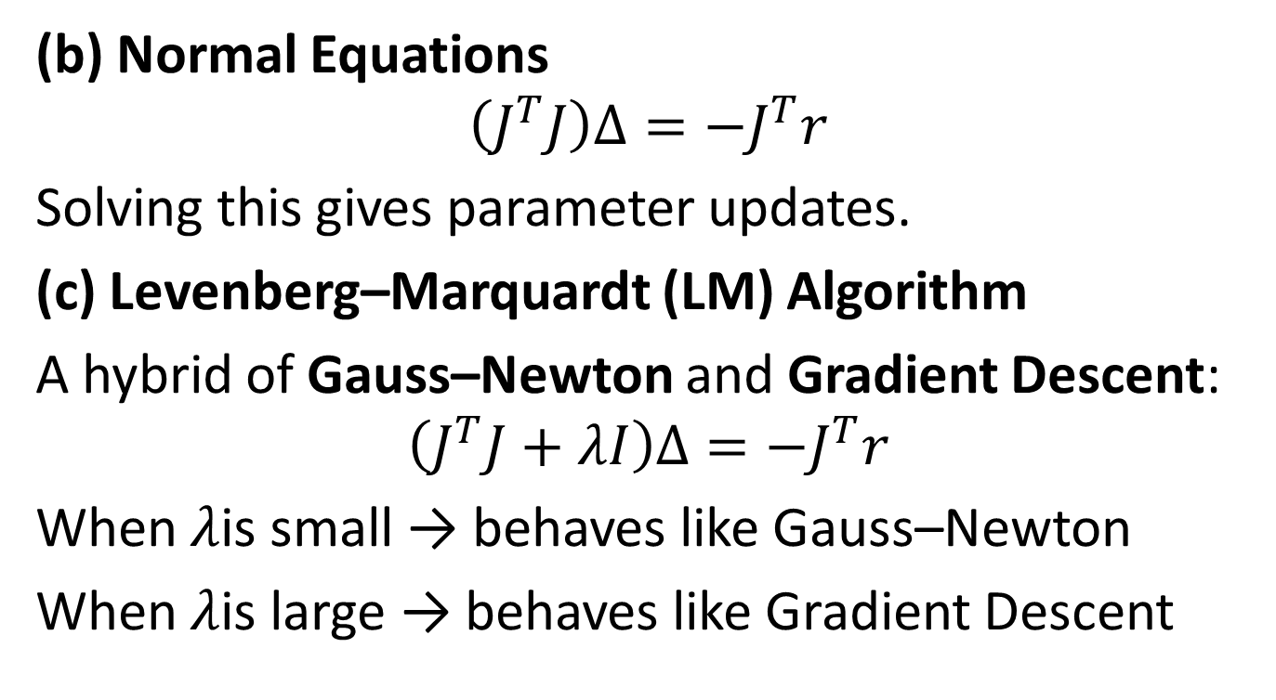
Optimization Strategies
(b) Normal Equations
$$\left(J^{T}J\right)Δ=−J^{T}r$$
Solving this gives parameter updates.
(c) Levenberg–Marquardt (LM) Algorithm
A hybrid of Gauss–Newton and Gradient Descent:
$$\left(J^{T}J+λI\right)Δ=−J^{T}r$$
When $λ$is small → behaves like Gauss–Newton
When $λ$is large → behaves like Gradient Descent

Slide 6

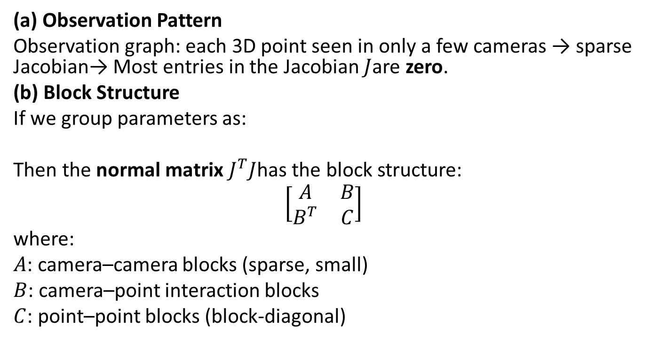
Exploiting Problem Structure: Sparsity
(a) Observation Pattern
Observation graph: each 3D point seen in only a few cameras → sparse Jacobian→ Most entries in the Jacobian $J$are zero.
(b) Block Structure
If we group parameters as:
Then the normal matrix $J^{T}J$has the block structure:
$$\left[\begin{matrix}A & B \\ B^{T} & C\end{matrix}\right]$$
where:
$A$: camera–camera blocks (sparse, small)
$B$: camera–point interaction blocks
$C$: point–point blocks (block-diagonal)

Slide 7
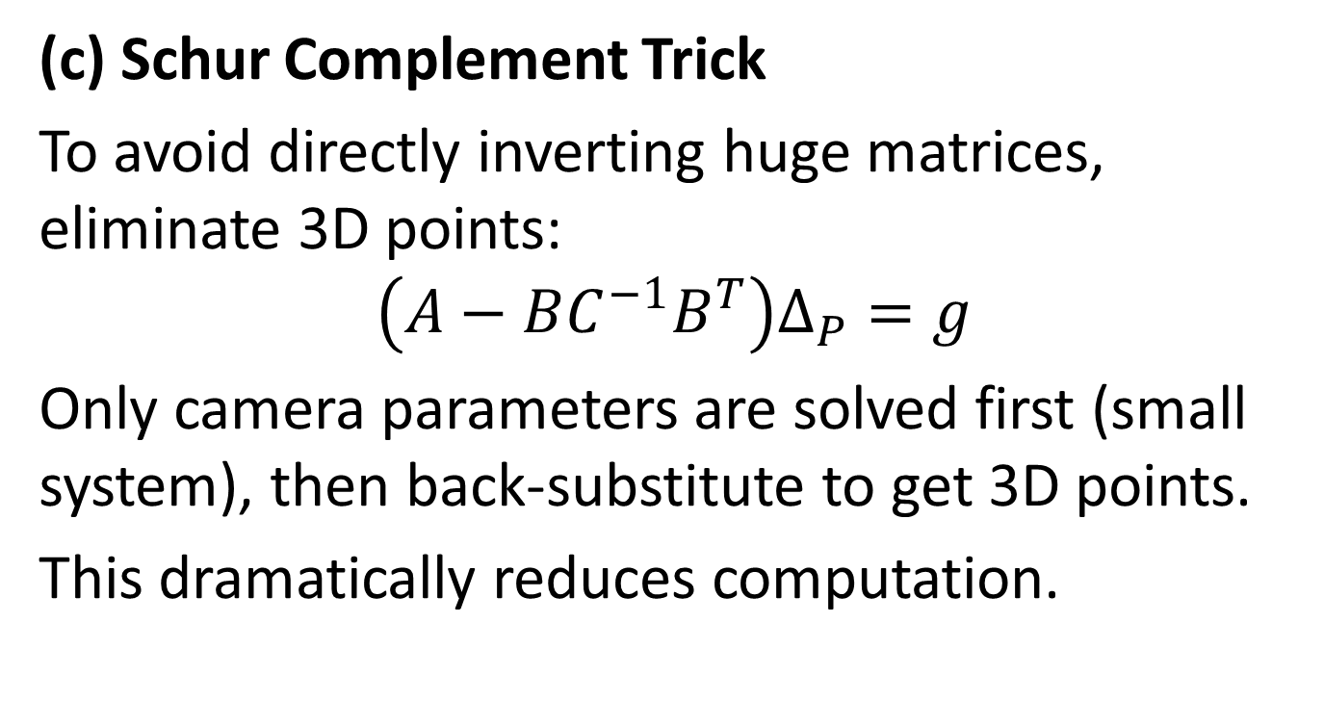
Exploiting Problem Structure: Sparsity
(c) Schur Complement Trick
To avoid directly inverting huge matrices, eliminate 3D points:
$$\left(A−BC^{−1}B^{T}\right)Δ_{P}=g$$
Only camera parameters are solved first (small system), then back-substitute to get 3D points.
This dramatically reduces computation.

Slide 8
Practical Implementation Insights
Libraries: Ceres Solver (Google), g2o, SBA, GTSAM
Techniques:
Sparse Cholesky factorization
Schur complement
Block-sparse matrix storage
Iterative refinement
Applications:
Visual SLAM
Structure-from-Motion (SfM)
Camera calibration and 3D reconstruction

Slide 9
Summary
Concept | Key Point
Goal | Minimize reprojection error over all images and 3D points
Problem Type | Nonlinear least squares
Algorithms | Gauss–Newton, Levenberg–Marquardt
Challenge | Large, sparse Jacobian
Solution | Exploit sparsity + Schur complement
Outcome | Drastic speedup in optimization
Used in | SLAM, SfM, 3D reconstruction

